Slide 2
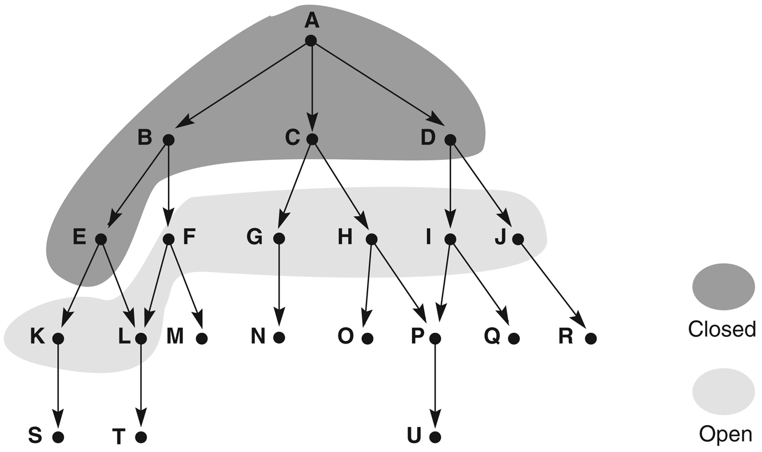
Figure 3.14: Graph of Figure 3.13 at iteration 6 of breadth-first search. States on open and closed are highlighted.

Slide 3
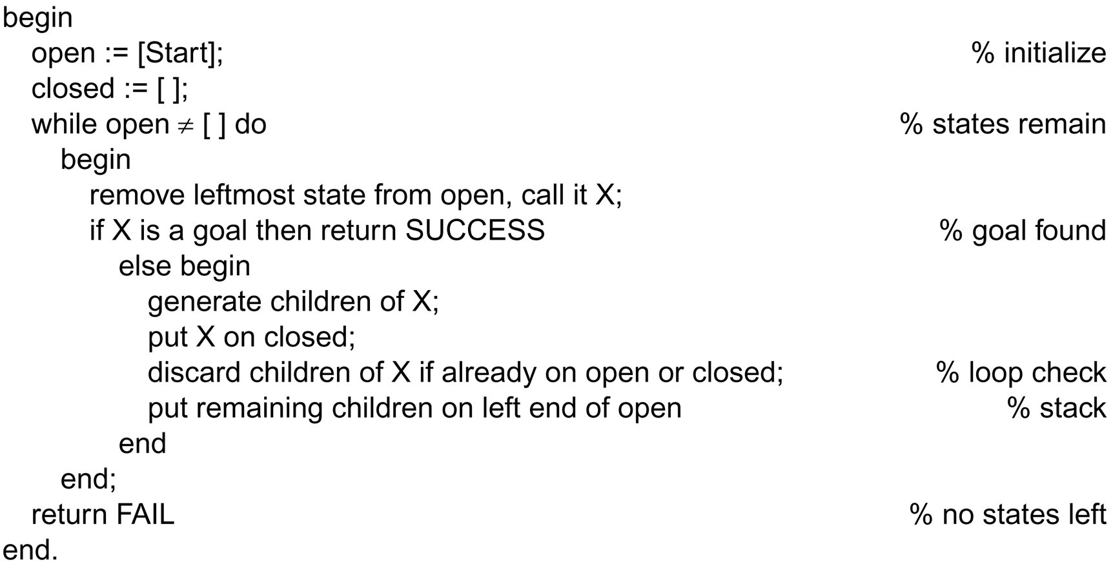
Function depth_first_search algorithm

Slide 4
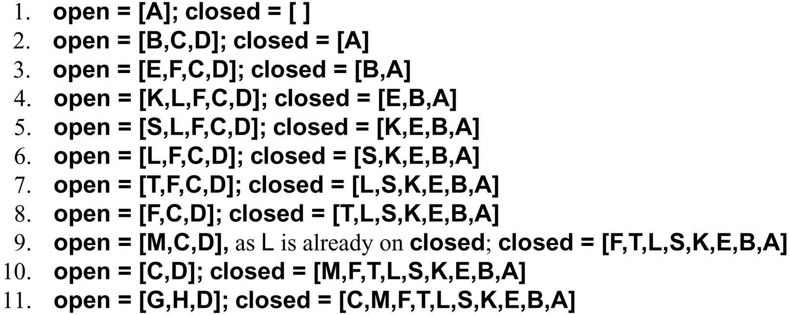
A trace of depth_first_search on the graph of Figure 3.13

Slide 5
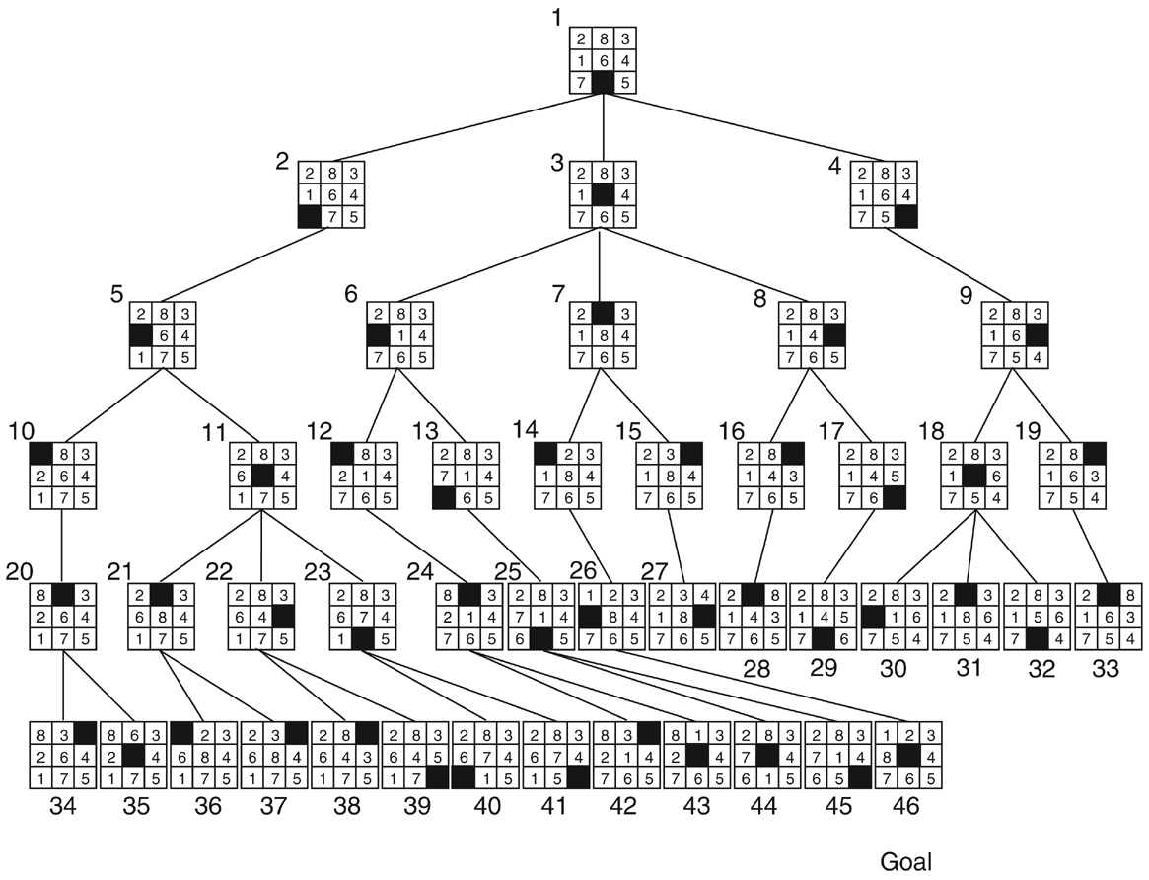
Figure 3.15: Breadth-first search of the 8-puzzle, showing order in which states were removed from open.

Slide 6
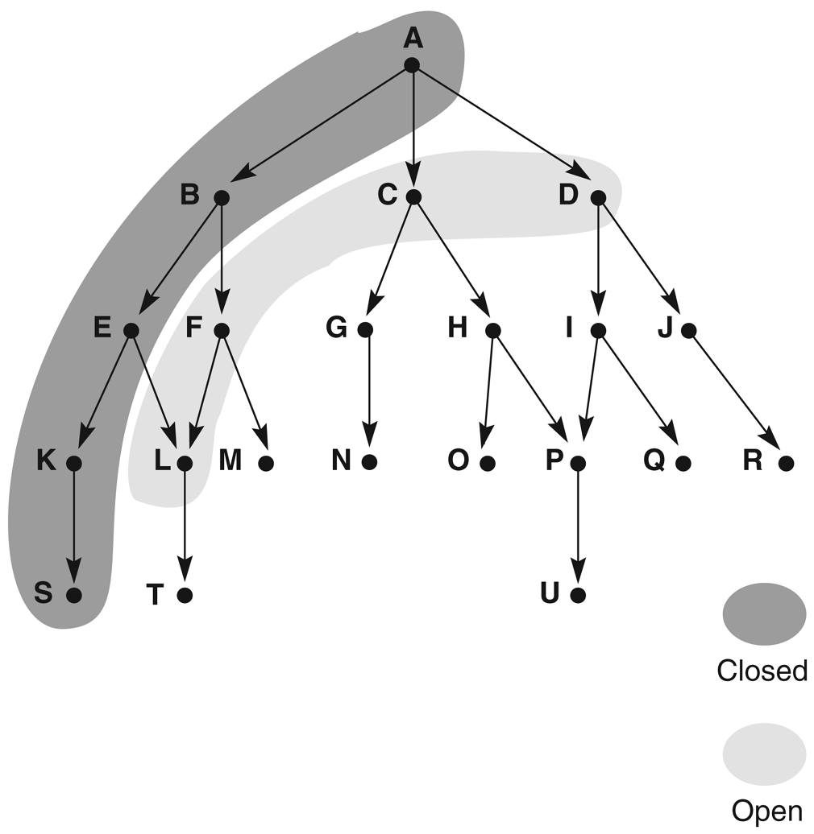
Figure 3.16: Graph of Figure 3.13 at iteration 6 of depth-first search. States on open and closed are highlighted.

Slide 7
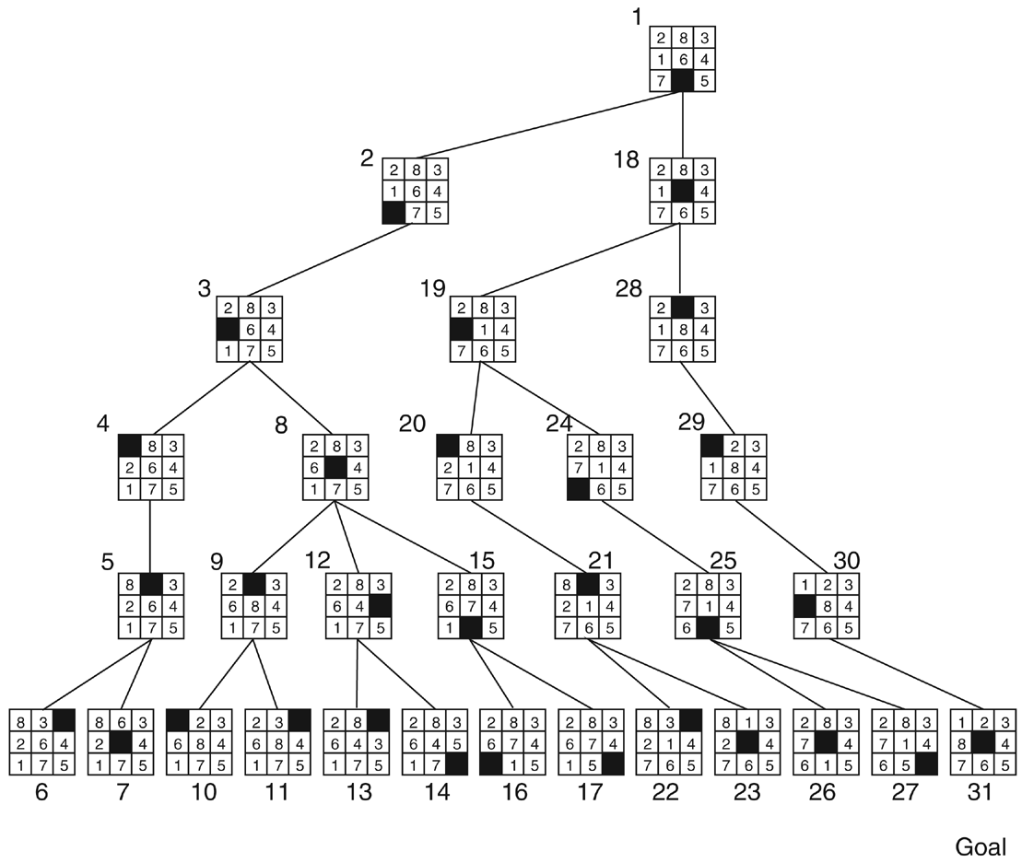
Figure 3.17: Depth-first search of the 8-puzzle with a depth bound of 5.

Slide 8
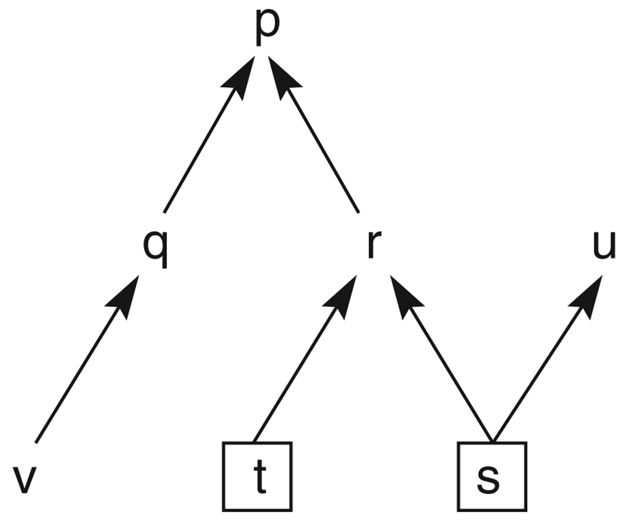
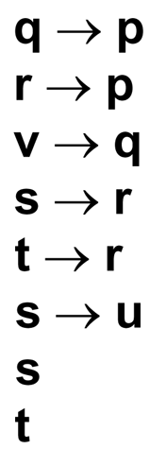
Figure 3.18: State space graph of a set of implications in the propositional calculus.

Slide 9
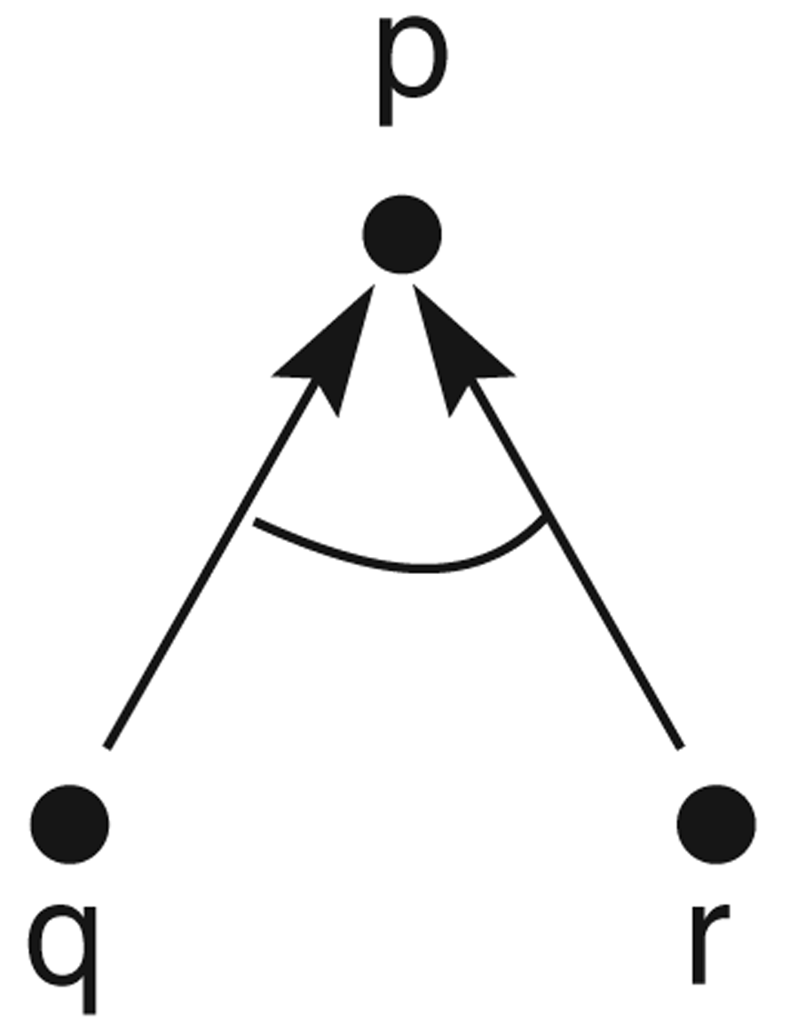
Figure 3.19: And/or graph of the expression q Ÿ r ∅ p.

Slide 10
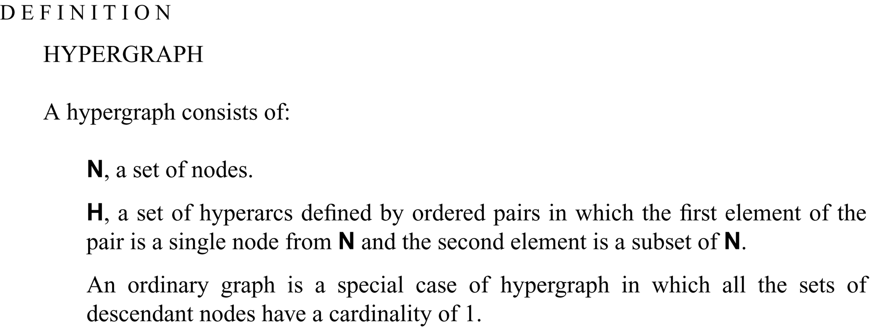

Slide 11
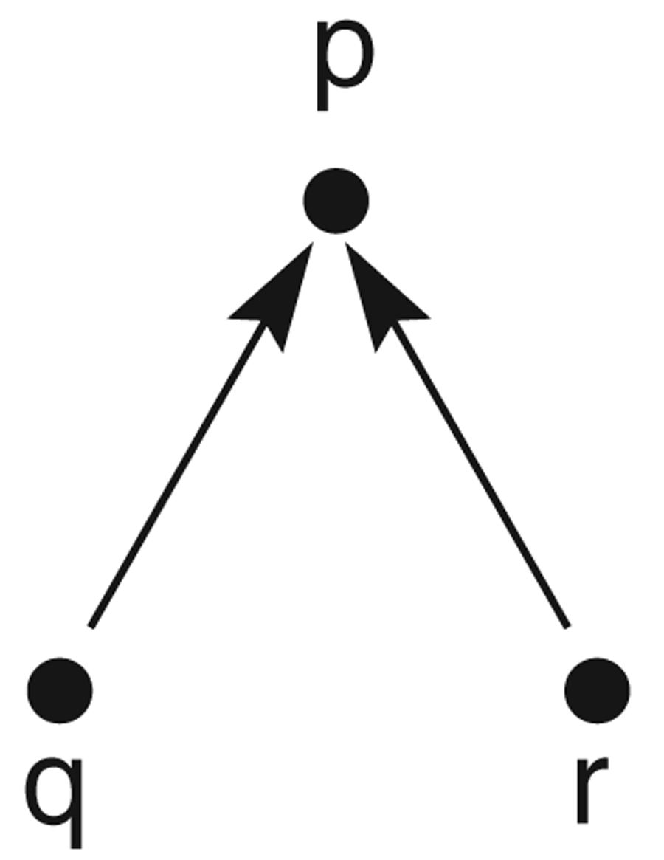
Figure 3.20: And/or graph of the expression q ⁄ r ∅ p.

Slide 12
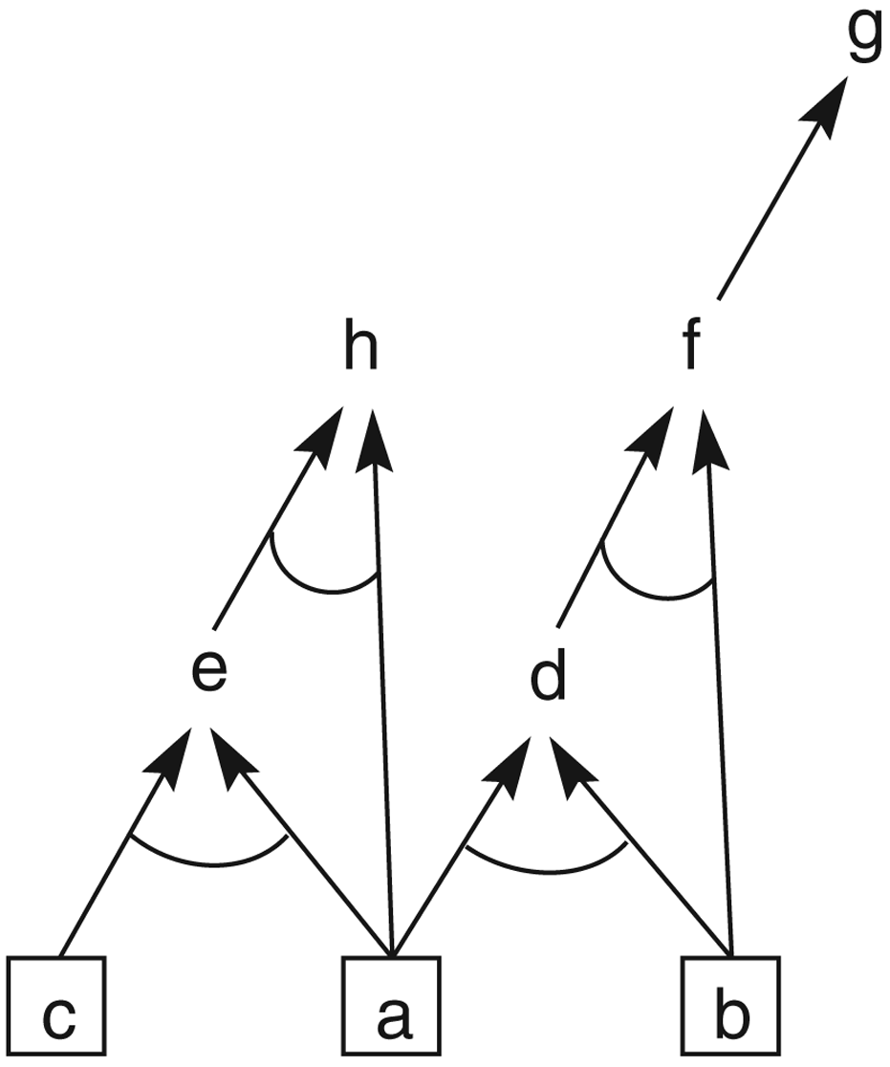
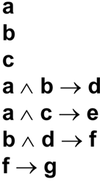
Figure 3.21: And/or graph of a set of propositional calculus expressions.

Slide 13
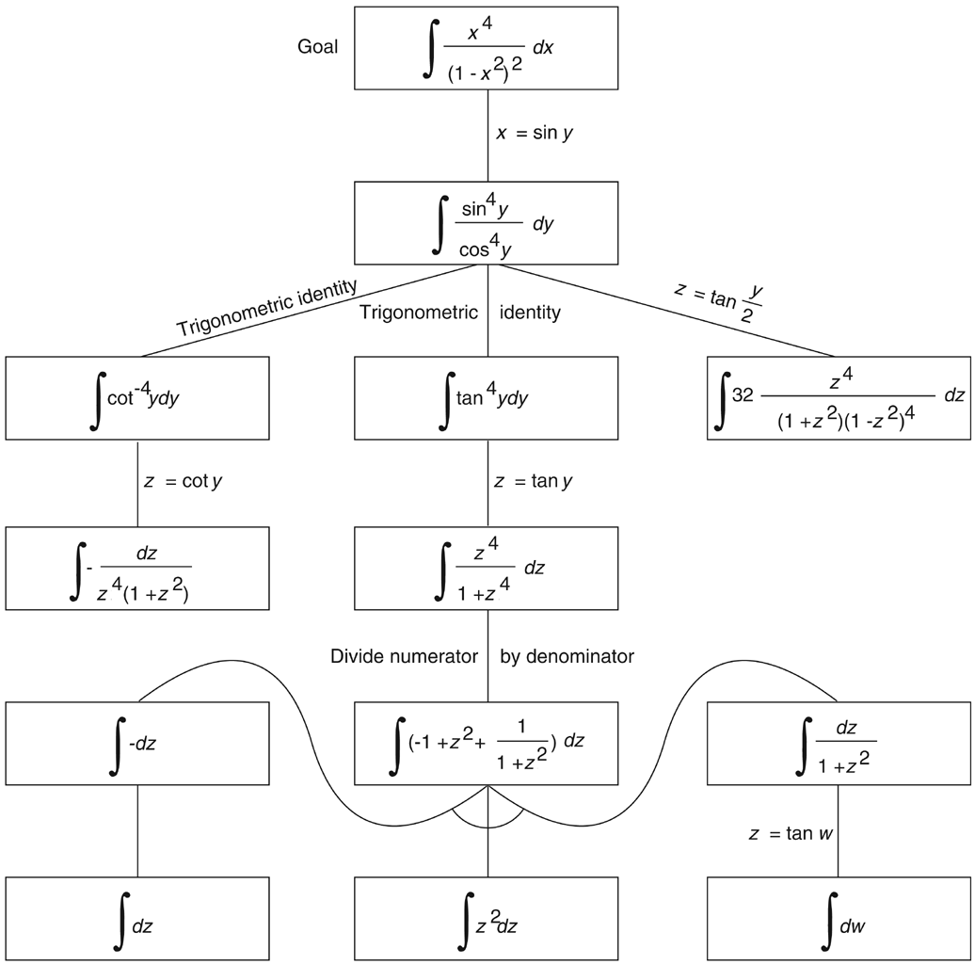
Figure 3.22: And/or graph of part of the state space for integrating a function, from Nilsson (1971).

Slide 14
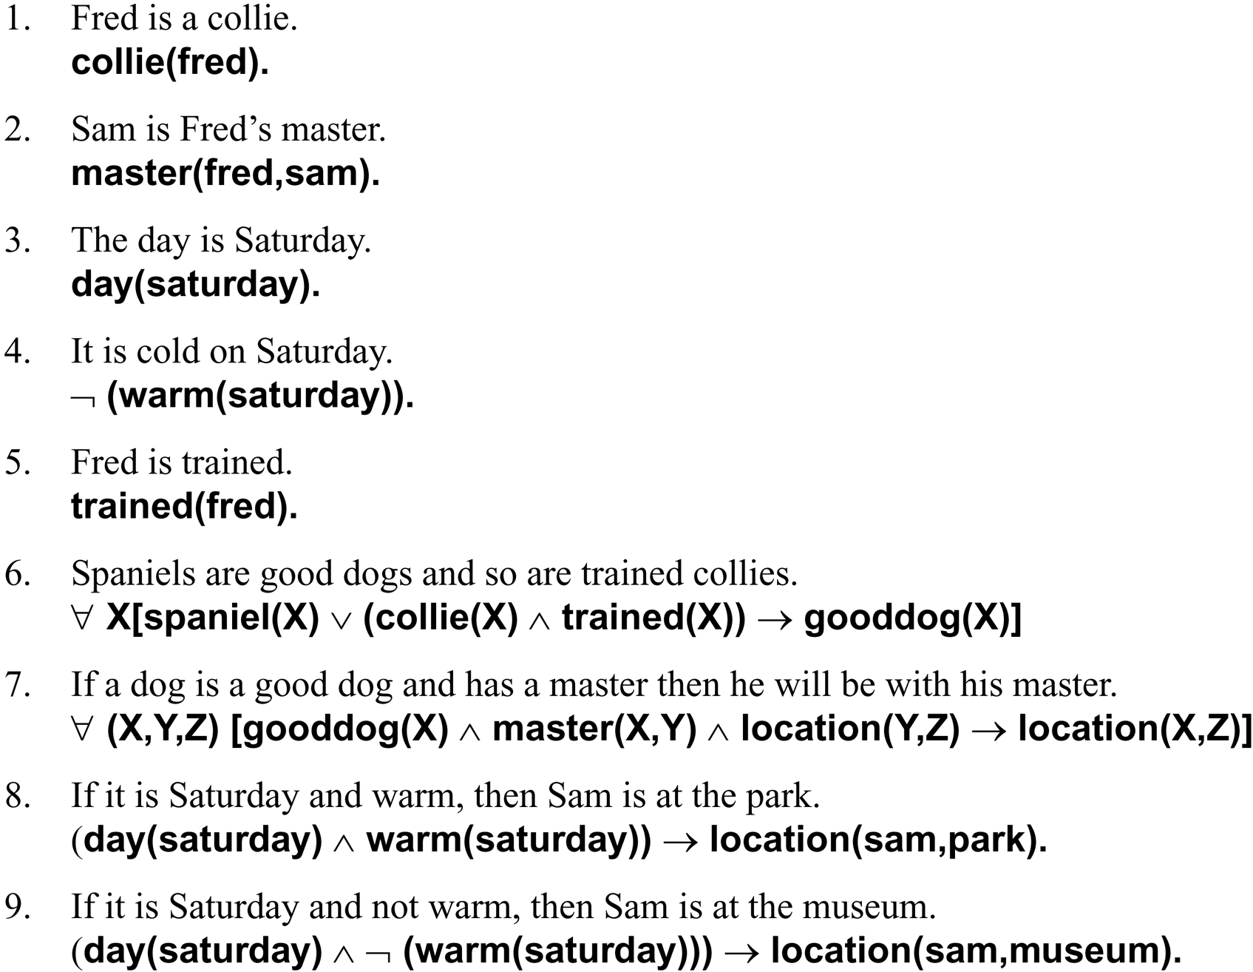
The facts and rules of this example are given as English sentences followed by their predicate calculus equivalents:

Slide 15
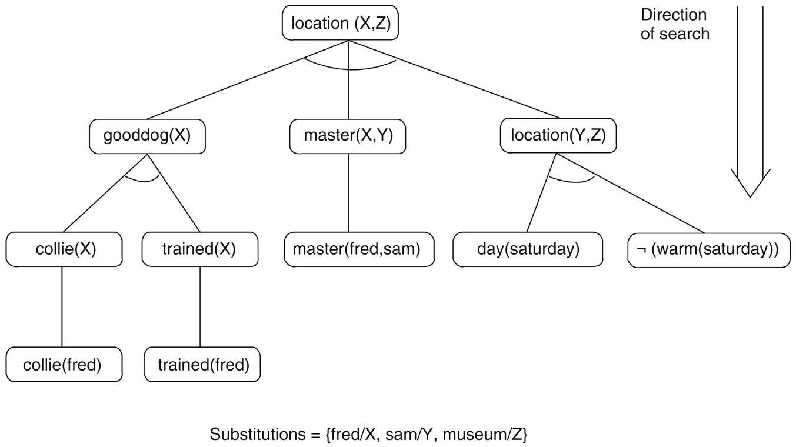
Figure 3.23: The solution subgraph showing that fred is at the museum.

Slide 16
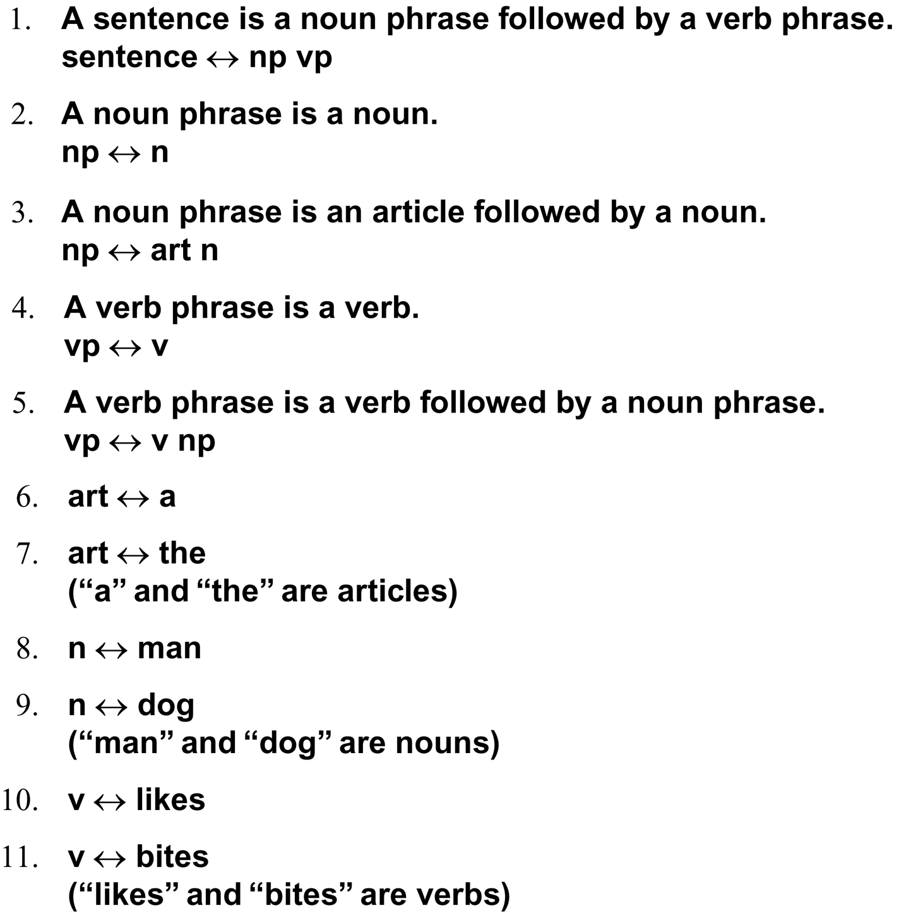
Five rules for a simple subset of English grammar are:

Slide 17
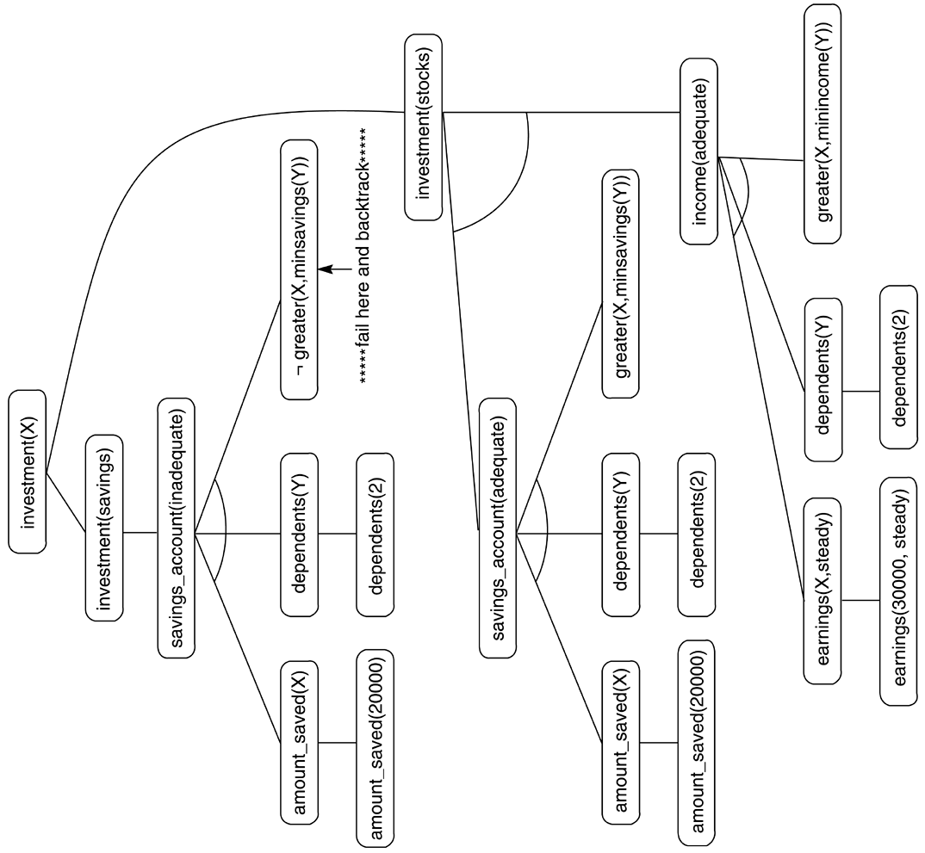
Figure 3.24: And/or graph searched by the financial advisor.

Slide 18
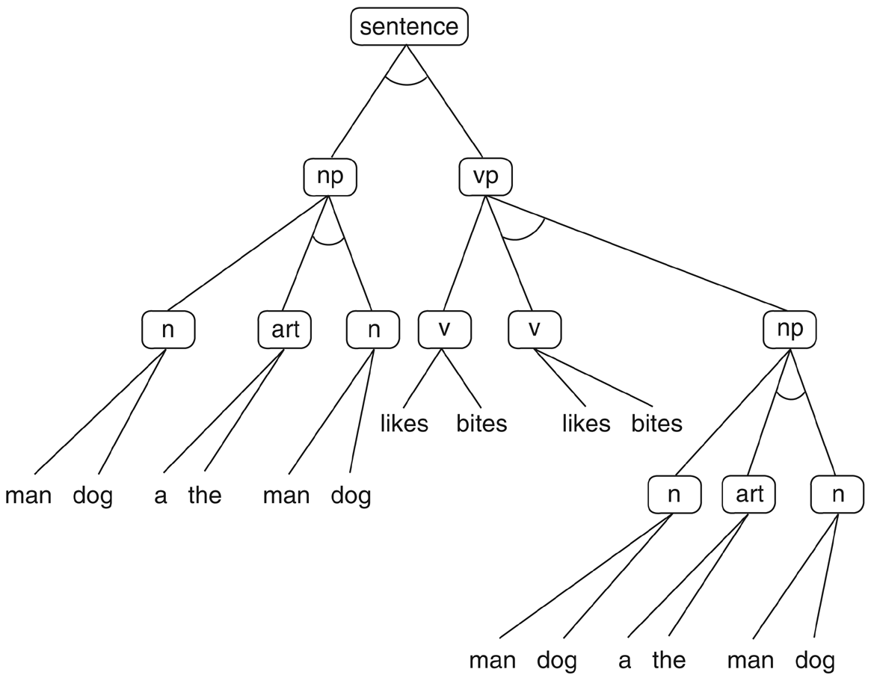
Figure 3.25: And/or graph for the grammar of Example 3.3.6. Some of the nodes (np, art, etc.) have been written more than once to simplify drawing the graph.

Slide 19
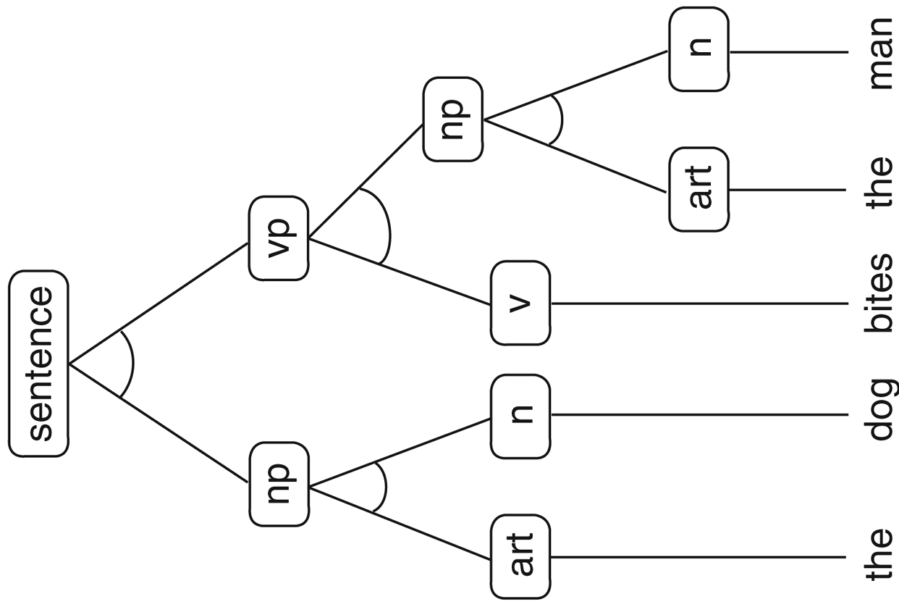
Figure 3.26: Parse tree for the sentence “The dog bites the man.” Note that this is a subtree of the graph of Figure 3.25.

Slide 20
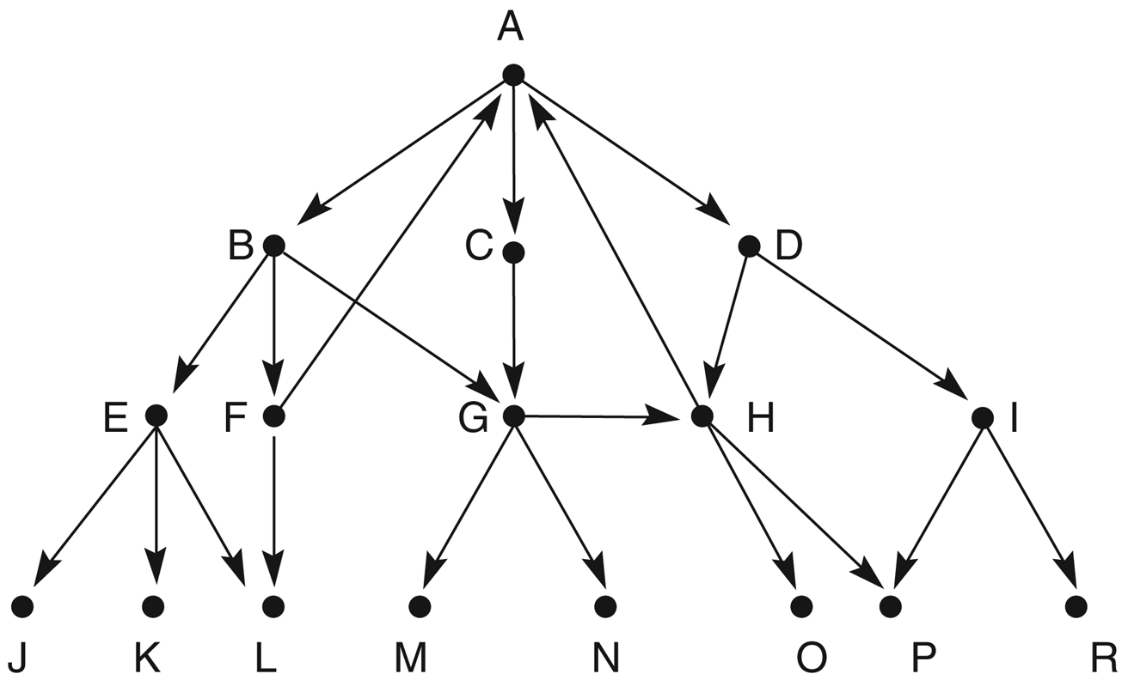
Figure 3.27: A graph to be searched.

